Slide 1

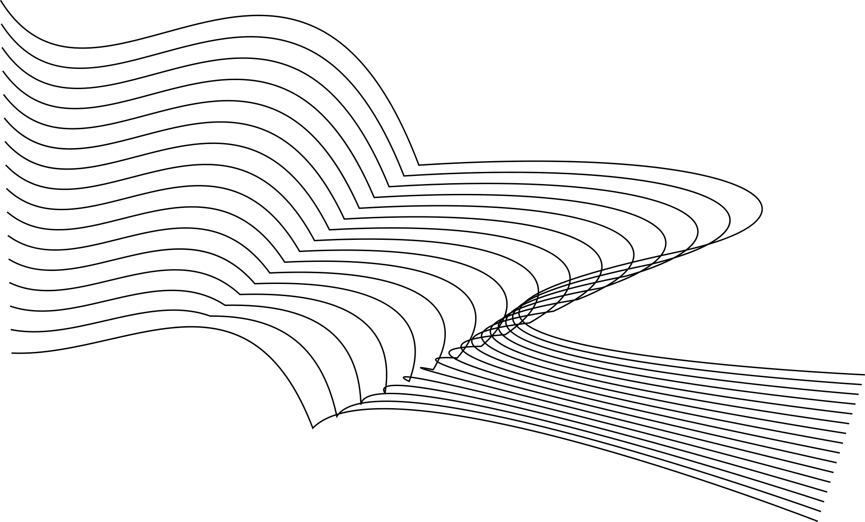
AI CHATBOT & RAG AI SYSTEM
by Janaki R
Reflections Info Systems Pvt Ltd.

Slide 2
PROJECT OVERVIEW
This presentation covers two AI-based projects:
1. AI Chatbot using Groq API
2. RAG-based PDF Chatbot
These projects demonstrate how AI can improve automated communication and document-based information retrieval.
01

Slide 3
Task 1:
AI Chatbot

Slide 4
Task 1
Overview
The AI Chatbot is a simple conversational assistant built using the Groq API.
Main functions:
• Answer user questions
• Maintains conversation history
• Generates real-time responses
The project helped in understanding how Large Language Models (LLMs) work.
02

Slide 5
BUSINESS PURPOSE
& FEATURES
Businesses often need automated systems to respond to user queries quickly.
• Businesses need faster customer interaction systems
• Manual responses take time
• Repetitive queries increase workload
Key Features:
• Real-time AI responses
• Multi-turn conversation memory
• Adjustable AI behaviour
• Secure API key handling using .env
03

Slide 6
CONTRIBUTION & CHALLENGES
My Contribution:
• Integrated Groq API
• Implemented chat history memory
• Added prompt customization
• Managed API security
Challenges Faced:
• Managing conversation history(Solved by storing messages in a messages list)
• Deprecated Model Issue (Solved by replacing the deprecated model with
llama-3.1-8b-instant)
04

Slide 7
Task 2:
RAG AI Chatbot

Slide 8
Task 2
Overview
The RAG AI System is a document-based AI chatbot that answers questions using uploaded PDF files.
Unlike a normal chatbot, this system retrieves relevant information from documents before generating responses.
Technologies used:
• LangChain
• ChromaDB
• HuggingFace Embeddings
• Groq API
• Streamlit
05

Slide 9
BUSINESS PURPOSE & FEATURES
Organizations store a large amount of information in PDFs and reports.
• Searching manually takes time
• Important information is difficult to locate quickly
• Large PDFs are hard to navigate
The RAG system allows users to ask questions directly from documents and receive accurate context-based answers instantly.
Key Features are:
• Multiple PDF support
• Semantic search
• Chat history memory
• Streamlit web interface
• Source chunk display
• Persistent local database
• Context-aware AI responses
06

Slide 10
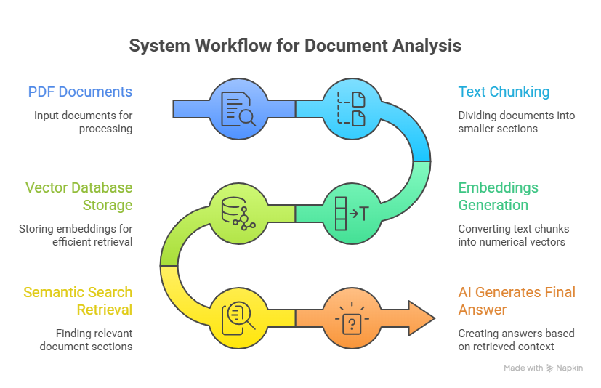
HOW THE RAG SYSTEM WORKS
07

Slide 11
CONTRIBUTION & CHALLENGES
My Contribution:
• Built the complete RAG pipeline
• Implemented PDF chunking and embeddings
• Integrated ChromaDB vector database
• Developed the Streamlit frontend UI
• Added logging and persistent storage
Challenges Faced:
• Understanding Vector Similarity (Solved by learning how embeddings capture meaning)
• Slow embedding generation (Solved using persistent ChromaDB storage)
• Chat history reset during reloads (Solved by using session_state in Streamlit)
08

Slide 12
RESULTS
Testing Performed:
• Asked multiple PDF-related questions
• Verified correct chunk retrieval
• Compared answers with and without RAG
• Tested different retrieval settings
Observations:
• RAG produced more accurate answers
• Semantic search improved retrieval quality
• Streamlit improved usability
09

Slide 13
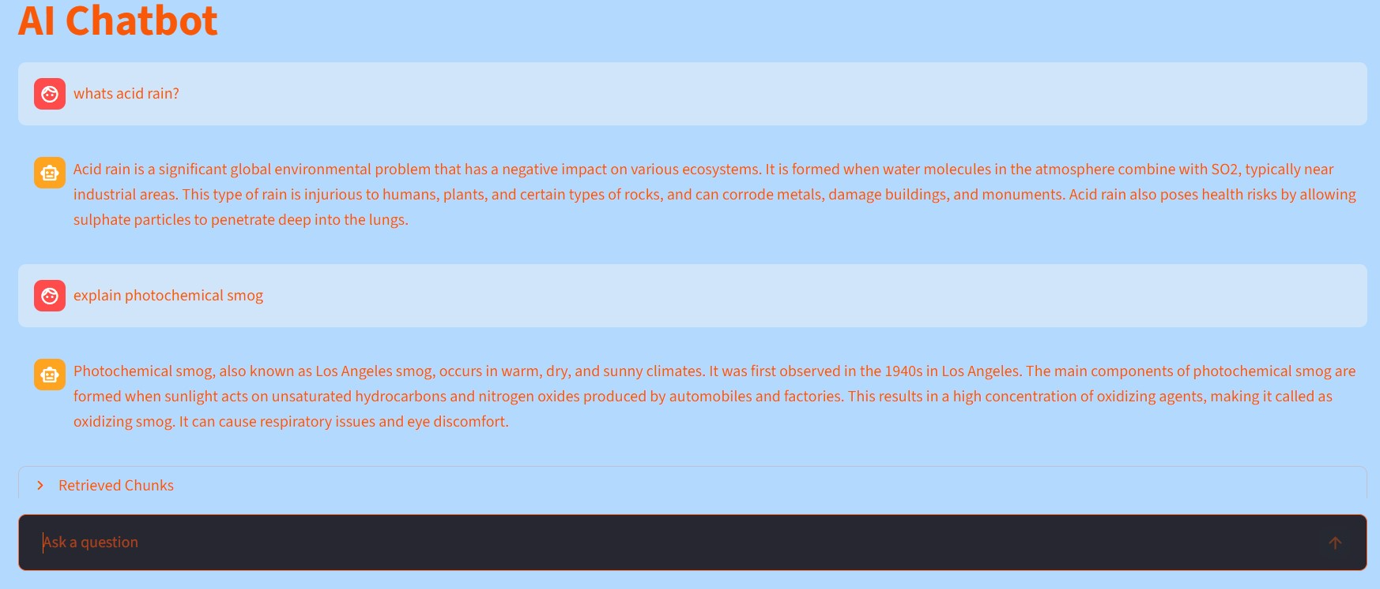
SCREENSHOTS
10

Slide 14
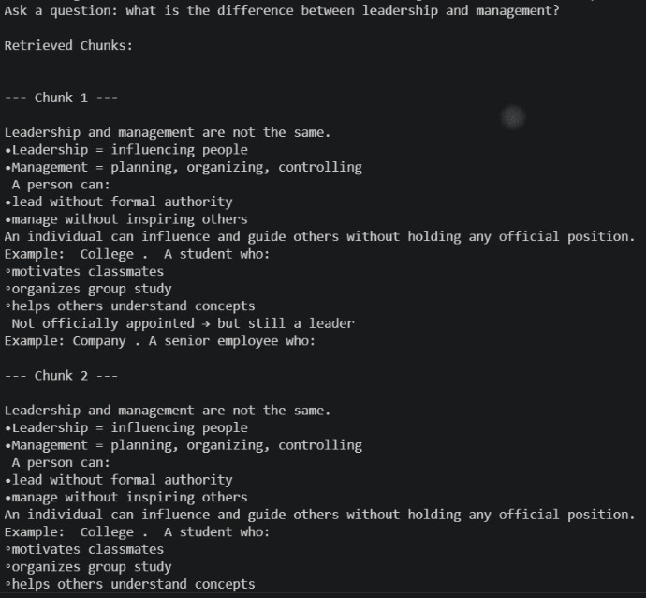
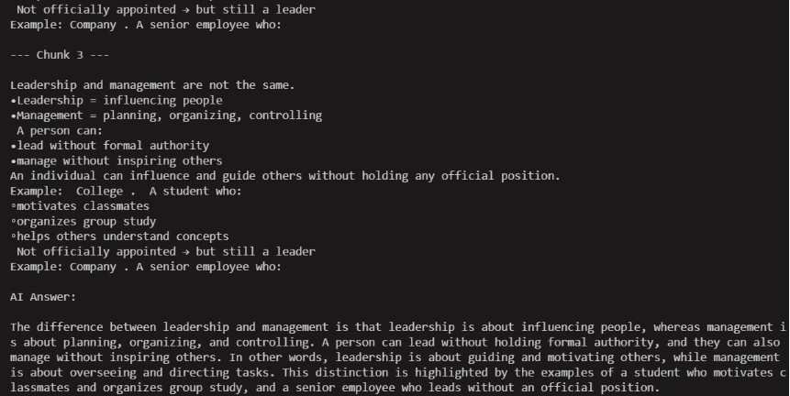
11

Slide 15
FUTURE IMPROVEMENTS
• Support more file formats
• Improve retrieval accuracy
• Add file upload support
• Improve the Streamlit UI
• Add source citations
• Optimize retrieval speed
• Add response feedback system for users
12

Slide 16
CONCLUSION
These projects helped in understanding:
• Conversational AI systems
• Retrieval-Augmented Generation (RAG)
• Semantic search and vector databases
• Context-aware AI applications
The projects also provided practical experience in building real-world AI applications using modern AI tools and frameworks.
13

Slide 17
THANK YOU

